Slide 1

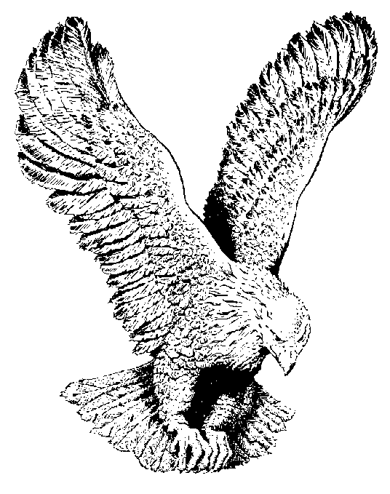
17
MY SHEEP KNOW MY VOICE
My sheep know My voice,
And the path that I take,
They follow wherever I go;
My sheep know My voice
And come at My call,
But a stranger’s voice do they not know.

Slide 2
CHORUS
My sheep know My voice,
And day by day,
They abide in the fold,
And go not astray;
They love Me because
I have made them My choice,
And they follow My call,
For My sheep know My voice.

Slide 3
My sheep know My voice,
And the pastures of green,
Where I lead them so often to feed;
My sheep know My voice,
And the cool sparkling stream,
Where beside its still waters I lead.

Slide 4
My sheep know My voice,
And the valley of death,
Thru which I shall lead them some day;
But no danger nor harm
Can touch one of them,
For I will be with them alway

